Slide 1

Puducherry Technological University
Department of Information Technology
AGRITWIN-GH: AGRICULTURAL DIGITAL TWIN FOR SMART GREENHOUSE HORTICULTURE OF TOMATO CULTIVATION
Under the Supervision of
Dr. V. Govindasamy
Professor
Department of Information Technology
Puducherry Technological University
Project By,
Mr. Arjun Christopher S (Reg No : 2201112007)
Miss. Bhuvanalakshmi J P (Reg No : 2201112009)
Miss. Vantapati Raja Rajeswari (Reg No : 2201112052)

Slide 2
Agenda
Abstract
Introduction to Digital Twin–based Greenhouse Management
Aligned Sustainable Development Goals
Overview of Techniques, Algorithms and Simulation Used
Literature Survey
Inference from Literature
Proposed AgriTwin-GH System
System Architecture of AgriTwin-GH
Project Modules
Module 1: Data Processing and AI-Based Crop Intelligence
Module 2: Predictive Analytics and Crop Health Forecasting
Module 3: Digital Twin Simulation and Intelligent Greenhouse Control
Results and Performance
Comparison with Existing Systems
Conclusion with Future Work
Datasets Used
References

Slide 3
Abstract
Greenhouse cultivation of high-value crops such as tomatoes faces challenges including environmental variability, delayed disease detection, inefficient resource usage, and reliance on reactive decision-making.
AgriTwin-GH is proposed as a software-based, AI-driven digital twin framework that integrates environmental modeling with plant health analysis for continuous monitoring and predictive decision support.
The system uses open-source datasets and plant image data, enabling a sensor-independent and scalable solution suitable for resource-constrained environments.
Deep learning models based on EfficientNet are used for crop growth stage classification and disease detection, achieving accuracies of 98.61% and 98.23%, respectively.
For prediction, a hybrid weather forecasting approach integrates transformer-based Chronos-T5, XGBoost, and LSTM models to capture both long-term patterns and short-term variations, improving accuracy.
The system also includes a digital twin simulation layer combined with Model Predictive Control (MPC), which uses data-driven greenhouse models to simulate future conditions and optimize control actions while considering resource usage and disease risk. A web-based interface and 3D visualization provide real-time insights.

Slide 4
Introduction to Digital Twin–based Greenhouse Management
Digital Twin technology enables the creation of a virtual representation of a physical greenhouse system that mirrors real-world behavior using continuous data updates.
It integrates data acquisition, system modeling, and intelligent analytics to monitor current conditions, predict future states, and support decision-making.
In greenhouse environments, the digital twin models critical parameters such as temperature, humidity, light intensity, CO₂ levels, irrigation, and nutrient conditions.
Traditional greenhouse systems rely on reactive control and manual observation, leading to delayed responses, inefficient resource usage, and reduced productivity.
Digital Twin–based systems overcome these limitations by enabling predictive analysis and proactive management of environmental conditions and crop health.
It forms a closed-loop system where real-time data is continuously processed, analyzed, and used to generate optimized control actions.
The integration of digital twin technology in greenhouse management improves decision accuracy, resource efficiency, and overall sustainability.

Slide 5
Aligned Sustainable Development Goals
SDG 2: Zero Hunger – The project enhances crop productivity, quality, and reliability by enabling early detection of plant diseases and accurate growth stage prediction, allowing timely interventions and maintaining optimal environmental conditions for stable and efficient food production
SDG 9: Industry, Innovation, and Infrastructure – The project leverages digital twin technology, artificial intelligence, and real-time virtual greenhouse systems to introduce advanced, scalable, and sensor-independent smart agriculture solutions, promoting innovation and modern infrastructure development
SDG 12: Responsible Consumption and Production – The project ensures efficient utilization of water and energy, through predictive analytics and simulation-based optimization, reducing resource wastage and minimizing environmental impact while supporting sustainable agricultural practices

Slide 6
Overview of Techniques, Algorithms and Simulation Used
Data Preprocessing & Feature Engineering
Data preprocessing ensures that raw greenhouse datasets are cleaned, structured, and reliable by handling missing values using interpolation techniques and removing noise or outliers through statistical filtering methods.
Feature engineering derives important agronomic indicators such as Vapor Pressure Deficit (VPD) and dew point, which are critical for understanding plant stress, growth conditions, and disease development.
Convolutional Neural Networks (CNN)
Convolutional Neural Networks are deep learning architectures designed for image analysis, capable of automatically extracting spatial features such as edges, textures, and patterns from plant images without manual feature engineering.
In this system, CNNs are used for identifying plant diseases and classifying crop growth stages based on visual characteristics, improving accuracy and reducing dependency on manual inspection.

Slide 7
Overview of Techniques, Algorithms and Simulation Used (Contd..)
Transfer Learning
Transfer learning allows the reuse of pre-trained deep learning models trained on large datasets, enabling faster training and improved performance when applied to specific agricultural tasks.
Instead of building models from scratch, the system fine-tunes learned features from existing models to adapt them to plant image datasets, significantly reducing computational cost and data requirements.
EfficientNet Architecture
EfficientNet is an advanced convolutional neural network architecture that achieves high accuracy by balancing network depth, width, and input resolution using a compound scaling method.
It provides superior performance compared to traditional CNNs while requiring fewer parameters and computational resources, making it efficient for real-world applications.
In this system, EfficientNet is used as the backbone model for both growth stage classification and disease detection, enabling precise and reliable image-based predictions.

Slide 8
Overview of Techniques, Algorithms and Simulation Used (Contd..)
Image Data Augmentation
Image data augmentation artificially increases dataset diversity by applying transformations such as rotation, flipping, scaling, cropping, and brightness adjustments to existing images.
These transformations simulate real-world variations in lighting, orientation, and environmental conditions, helping the model generalize better to unseen data.
Long Short-Term Memory (LSTM)
LSTM is a type of recurrent neural network designed to capture long-term dependencies in sequential data using gated memory mechanisms, making it highly suitable for time-series analysis.
It is used to analyze environmental parameters such as temperature, humidity, and VPD over time to predict future greenhouse conditions accurately.
Ensemble Learning
Ensemble learning combines multiple machine learning models to improve overall predictive performance by reducing variance, bias, and overfitting.
This approach is particularly useful in greenhouse environments where data is dynamic and complex, requiring robust and adaptive modeling.

Slide 9
Overview of Techniques, Algorithms and Simulation Used (Contd..)
Chronos
Chronos is a transformer-based time-series model that captures complex temporal dependencies across multiple environmental variables using pre-trained representations.
It can model non-linear relationships and long-term patterns effectively, making it suitable for forecasting dynamic greenhouse conditions.
Extreme Gradient Boosting (XGBoost)
XGBoost is a powerful ensemble learning algorithm that uses gradient boosting over decision trees to model complex non-linear relationships in structured environmental data.
It processes engineered features such as temperature, humidity, and VPD to generate accurate predictions for environmental conditions and disease risks.
Random Forest
Random Forest is an ensemble learning technique that builds multiple decision trees and combines their outputs to improve prediction accuracy and reduce overfitting.
In this system, it is used for regression and classification tasks within predictive analytics to ensure stable and reliable outputs.

Slide 10
Overview of Techniques, Algorithms and Simulation Used (Contd..)
Histogram-Based Gradient Boosting
Histogram-based gradient boosting improves computational efficiency by grouping continuous features into discrete bins, reducing training time while maintaining high accuracy.
It is well-suited for large-scale greenhouse datasets with multiple features and time-series components.
Model Predictive Control (MPC)
Model Predictive Control is an optimization-based control strategy that predicts future greenhouse states using system models and determines optimal control actions.
It minimizes an objective function that considers environmental deviation, resource consumption, and disease risk.
By evaluating multiple control scenarios at each step, MPC enables proactive, adaptive, and optimized greenhouse management.

Slide 11
Overview of Techniques, Algorithms and Simulation Used (Contd..)
ARX
The AutoRegressive with Exogenous Inputs (ARX) model is used to represent greenhouse system dynamics by modeling relationships between current states and external control inputs.
It considers environmental variables such as temperature, humidity, and CO₂ along with control actions like ventilation and irrigation.
This model enables the digital twin to simulate future greenhouse conditions and evaluate the impact of different control strategies before real-world implementation.
Unity-Based Digital Twin Simulation
A 3D virtual greenhouse environment is developed using the Unity engine to provide an interactive and immersive visualization of the digital twin system, representing crop stages, environmental conditions, and actuator states.
The model includes key components such as fans, vents, irrigation systems, and lighting, visually reflecting real-time system behavior and simplifying interpretation of complex greenhouse data.
The backend communicates with the Unity environment via API integration, enabling real-time updates of greenhouse conditions and control actions.

Slide 12
Literature Survey
S. No. | Title of Paper | Journal Title with Year of Publication & Author | Technical Description | Research Gap
1 | Optimizing Agricultural Data Analysis Techniques Through AI-Powered Decision-Making Processes | Elbasi, E., Mostafa, N., Zaki, C., AlArnaout, Z., Topcu, A. E., & Saker, L. Applied Sciences, Vol. 14, 2024. | The study focuses on preprocessing techniques for agricultural datasets including noise removal, dataset balancing, feature selection, and dimensionality reduction to improve machine learning model performance. | Focuses only on agricultural data preprocessing and does not address plant disease detection or greenhouse monitoring systems.
2 | Plant Leaf Disease Detection Using Ensemble Learning and Explainable Artificial Intelligence | Oad, A., Abbas, S. S., Zafar, A., et al. IEEE Access, Vol. 12, 2024. | Proposes an ensemble deep learning framework using CNN architectures such as VGG16, VGG19, InceptionV3, and ResNet101V2 for plant leaf disease classification using the PlantVillage dataset. | The system performs only disease classification and does not integrate environmental monitoring or crop growth prediction in greenhouse environments.
3 | Identifying Tomato Growth Stages in Protected Agriculture with StyleGAN3-Synthetic Images and Vision Transformer | Huo, Y., Liu, Y., He, P., Hu, L., Gao, W., & Gu, L. Agriculture, Vol. 15, Article 120, 2025. | Introduces a hybrid deep learning framework combining StyleGAN3 for synthetic image generation and Vision Transformer for accurate tomato growth stage recognition. | The study focuses only on growth stage identification and does not incorporate disease detection or integrated digital twin greenhouse management.

Slide 13
Literature Survey (Contd..)
S. No. | Title of Paper | Journal Title with Year of Publication & Author | Technical Description | Research Gap
4 | DL2F: A Deep Learning Model for the Local Forecasting of Renewable Sources | L. Caroprese, M. Pierantozzi, C. Lops, and S. Montelpare, Computers & Industrial Engineering, Vol. 187, 2024. | The study proposes a deep learning-based forecasting framework for meteorological variables relevant to renewable energy systems. It uses GRU-based recurrent neural. | The framework mainly improves existing numerical forecasts using a single deep learning model and does not provide independent hybrid forecasting or greenhouse-specific prediction.
5 | Deep Learning-Based Time Series Prediction for Precision Field Crop Protection | T. He, M. Li, and D. Jin, Frontiers in Plant Science, Vol. 16, 2025. | The study uses time-series sensor data, IoT monitoring, and advanced deep learning models such as recurrent networks, attention mechanisms, and transformers to identify crop growth stages in precision agriculture. | The approach mainly focuses on current growth stage classification and does not model future stage transitions or temporal progression.
6 | Greenhouse Industry 4.0 – Digital Twin Technology for Commercial Greenhouses | D. A. Howard, Z. Ma, C. Veje, A. Clausen, J. M. Aaslyng, and B. N. Jørgensen, Energy Informatics, Vol. 4, No. 1, 2021. | The paper presents an Industry 4.0-based digital twin framework integrating IoT, AI, cloud computing, and big data for greenhouse simulation. It models climate compartments, energy systems, and production. | The system emphasizes large-scale industrial optimization and infrastructure-level integration but gives limited attention to crop-level intelligence or disease prediction.

Slide 14
Literature Survey (Contd..)
S. No. | Title of Paper | Journal Title with Year of Publication & Author | Technical Description | Research Gap
7 | Optimal Strategy for Energy-Efficient Management of Greenhouse Climate Control | M. Ghiasi, Z. Wang, M. Mehrandezh, and A. Mohammadi, IEEE Open Access Journal of Power and Energy, Vol. 12, 2025. | The study develops a multi-objective optimization strategy for greenhouse climate control, focusing on minimizing energy consumption while maintaining suitable growth conditions. | The approach is mainly centered on energy optimization and environmental control and does not integrate real-time crop health monitoring, disease progression or growth intelligence.
8 | Detection and Classification of Diseases in Multi-Crop Leaves Using LSTM and CNN Models | S. Kanakala and S. Ningappa, Journal of Innovative Image Processing, Vol. 7, No. 1, 2025. | The study applies CNN and LSTM models to plant leaf image datasets for automated multi-class disease classification across multiple crop types. | The work is limited to static image-based disease classification and does not include disease progression forecasting or severity prediction.
9 | An Intelligent IoT-Based System Design for Controlling and Monitoring Greenhouse Temperature | A. F. Subahi and K. E. Bouazza, IEEE Access, Vol. 10, 2022. | The study proposes an IoT-based greenhouse monitoring and control system using sensors, cloud storage, and automated temperature regulation mechanisms. | The framework mainly supports environmental monitoring and rule-based control but lacks advanced predictive analytics, crop-specific intelligence, disease detection, and multi-objective optimization.

Slide 15
Inference from Literature
Existing studies emphasize preprocessing (noise removal, balancing, feature engineering) mainly for training readiness, highlighting the lack of a unified environmental data processing pipeline.
CNN-based disease detection methods achieve high accuracy but introduce high computational complexity and limited interpretability for real-time greenhouse deployment.
Single-model forecasting approaches lack robustness, showing the need for hybrid multi-model prediction frameworks.
Existing growth analysis treats plant development as static classification, lacking models that predict transition timelines, and progression behavior.
Disease detection methods are reactive and image-based, with limited integration of environmental and temporal factors for forecasting disease progression.
Current IoT and digital twin systems focus on infrastructure and environmental optimization, lacking fine-grained crop-level intelligence for precise decision-making.
Many frameworks rely on rule-based or single-model control, reducing adaptability and robustness under dynamic greenhouse conditions.

Slide 16
Proposed AgriTwin-GH System
AgriTwin-GH is an AI-driven system designed to enable intelligent and efficient greenhouse management through data-driven monitoring and control.
The system combines environmental data and plant image analysis to provide a comprehensive understanding of crop conditions.
It utilizes advanced machine learning and deep learning models to analyze current states and generate predictive insights.
The system supports early detection of risks such as disease and suboptimal growth conditions, enabling timely interventions.
A digital twin component creates a virtual representation of the greenhouse to simulate and validate control strategies.
Intelligent decision-making mechanisms optimize key operations such as irrigation, ventilation, temperature, and lighting.
The system operates in real time, continuously adapting to changing conditions within the greenhouse environment.
Overall, it transforms greenhouse management from a reactive approach to a predictive and proactive system.

Slide 17
System Architecture of AgriTwin-GH
The AgriTwin-GH system architecture integrates environmental datasets and plant image data into a unified framework to enable intelligent greenhouse monitoring and predictive crop analysis
Input Layer: Environmental parameters such as temperature, humidity, solar radiation, wind speed, CO₂, and VPD, along with plant image datasets, provide both physical and visual information required for accurate crop analysis.
Processing Layer: Data is processed through stages including preprocessing, cleaning, feature engineering, image-based crop intelligence, predictive analytics, and digital twin-based decision support to generate meaningful insights.
Modular Design:
Module I: Data Processing and AI-Based Crop Intelligence
Module II: Predictive Analytics and Crop Health Forecasting
Module III: Digital Twin Simulation and Intelligent Greenhouse Control
Output Layer: Provides plant health and disease assessment, identifies crop growth stage, supports predictive insights, and generates optimized control decisions for efficient greenhouse management.

Slide 18
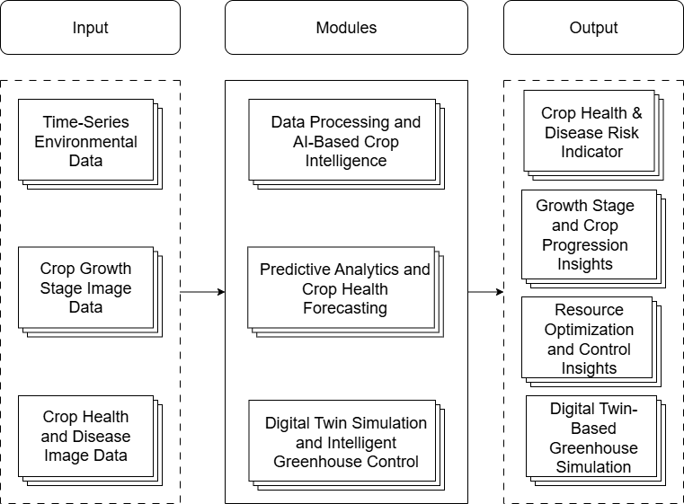
System Architecture of AgriTwin-GH (Contd..)
Fig: High-Level Architecture Diagram of AgriTwin-GH

Slide 19
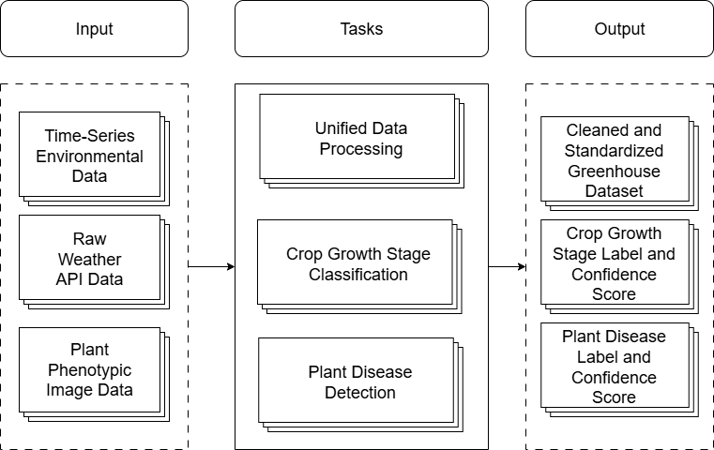
Project Modules
Module I – Data Processing and AI-Based Crop Intelligence
This module forms the foundation of the AgriTwin-GH system by converting raw environmental data into structured crop intelligence for further analysis.
Feature engineering is applied to derive key agronomic indicators such as temperature, humidity, CO₂, VPD, dew point, and leaf wetness for accurate greenhouse condition analysis.
AI-based models are used for crop growth stage classification and plant disease detection, enabling reliable monitoring of crop development and health.
Fig. Task-Level Architecture of Data Processing and AI-Based Crop Intelligence Module

Slide 20
Project Modules (Contd..)
Task 1 – Unified Data Processing
This task focuses on transforming raw environmental data obtained from external weather sources into a structured and standardized greenhouse dataset suitable for AI-based analysis and modeling.
Raw data often contains missing values, noise, inconsistencies, and anomalies, which are handled through systematic data validation, cleaning, and preprocessing techniques to improve data reliability.
Ensures temporal synchronization so that all environmental parameters are aligned on a consistent time axis for accurate analysis.
Feature engineering techniques are applied to extract meaningful greenhouse indicators, including temperature variations, humidity trends, and other agronomic parameters.
The process includes data ingestion, preprocessing, parameter alignment, and generation of a high-quality dataset that serves as input for downstream machine learning and deep learning models.

Slide 21
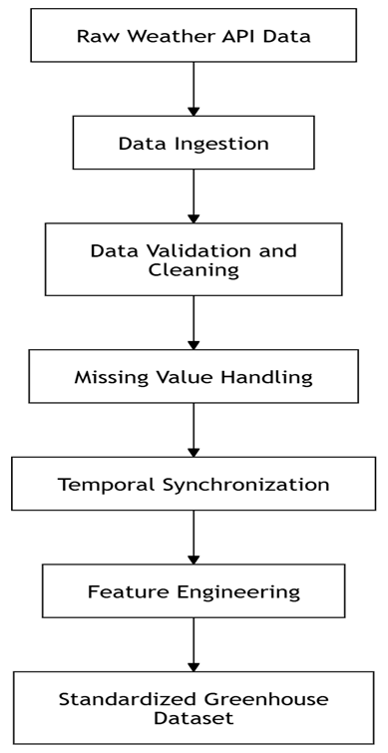
Project Modules (Contd..)
Fig. Data Processing Pipeline Architecture

Slide 22
Project Modules (Contd..)
Task 2 – Crop Growth Stage Classification
This task automatically identifies the developmental stage of tomato plants using image-based deep learning.
The system processes plant images through a pipeline of preprocessing, feature extraction, classification, and probability estimation.
Images are classified into six biological stages: Seedling, Early Vegetative, Flowering Initiation, Flowering, Unripe Fruit, and Ripe Fruit, based on gradual morphological and color transitions.
The architecture combines a pre-trained EfficientNetB3 with a custom classification head including pooling, dense layers, batch normalization, and dropout for stable and robust learning.
A two-phase training strategy is applied, involving initial training of the classification head followed by fine-tuning of upper layers.
Controlled data augmentation and class balancing techniques are used to improve generalization while preserving important biological features.
The model produces probability-based outputs across all growth stages, enabling confidence-driven decision-making in greenhouse management.

Slide 23
Project Modules (Contd..)
Task 3 – Plant Disease Detection
This task identifies and classifies diseases in tomato plants using image-based deep learning.
The system processes leaf images through preprocessing, feature extraction, classification, and probability estimation to ensure accurate predictions.
Images are classified into six categories: Early Blight, Late Blight, Leaf Mold, Powdery Mildew, Spider Mites, and Healthy Leaf based on visible symptoms.
The architecture includes a pre-trained EfficientNetB0 as backbone with a custom classification head using pooling, dense layers, batch normalization, and dropout for robust learning.
A two-stage transfer learning strategy is applied, involving initial training of classification layers followed by fine-tuning of upper backbone layers.
Data augmentation techniques such as rotation, flipping, zooming, and brightness adjustments improve model generalization across varying conditions.
The model outputs probability distributions over disease classes, enabling accurate classification along with confidence estimation for decision-making.

Slide 24
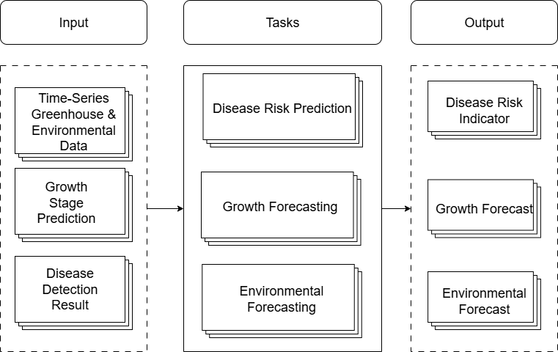
Project Modules (Contd..)
Module II – Predictive Analytics and Crop Health Forecasting
This module analyzes processed environmental data to generate predictive insights for greenhouse conditions and crop health.
It uses time-series and machine learning models to capture temporal patterns in environmental parameters such as temperature, humidity, and VPD.
The module predicts future environmental conditions, crop growth progression, and disease risk trends to support proactive decision-making.
Fig. Task-Level Architecture of Predictive Analytics and Crop Health Forecasting Module

Slide 25
Project Modules (Contd..)
Task 1 – Environmental Forecasting
A hybrid multi-model forecasting framework is designed to predict short-term greenhouse climate variables (temperature, humidity, wind speed, solar radiation) at 24h and 48h horizons.
The system uses Chronos-T5 (transformer), XGBoost (tree-based), and LSTM (sequence model) to capture global temporal patterns, structured feature interactions, and sequential dependencies respectively.
Historical time-series data is chronologically split (70:15:15) and preprocessed with cleaning, temporal continuity, and feature engineering.
Chronos-T5 is fine-tuned using a two-stage training strategy (frozen → full fine-tuning).
XGBoost uses a direct multi-step approach with variable-specific regularization to handle differences in predictability across climate variables.
LSTM models are trained using 30-day sequences.
Final predictions are generated through Optuna-based ensemble blending, optimizing weights per variable and horizon for improved accuracy and robustness.
The system also includes sky-condition classification using Random Forest.

Slide 26
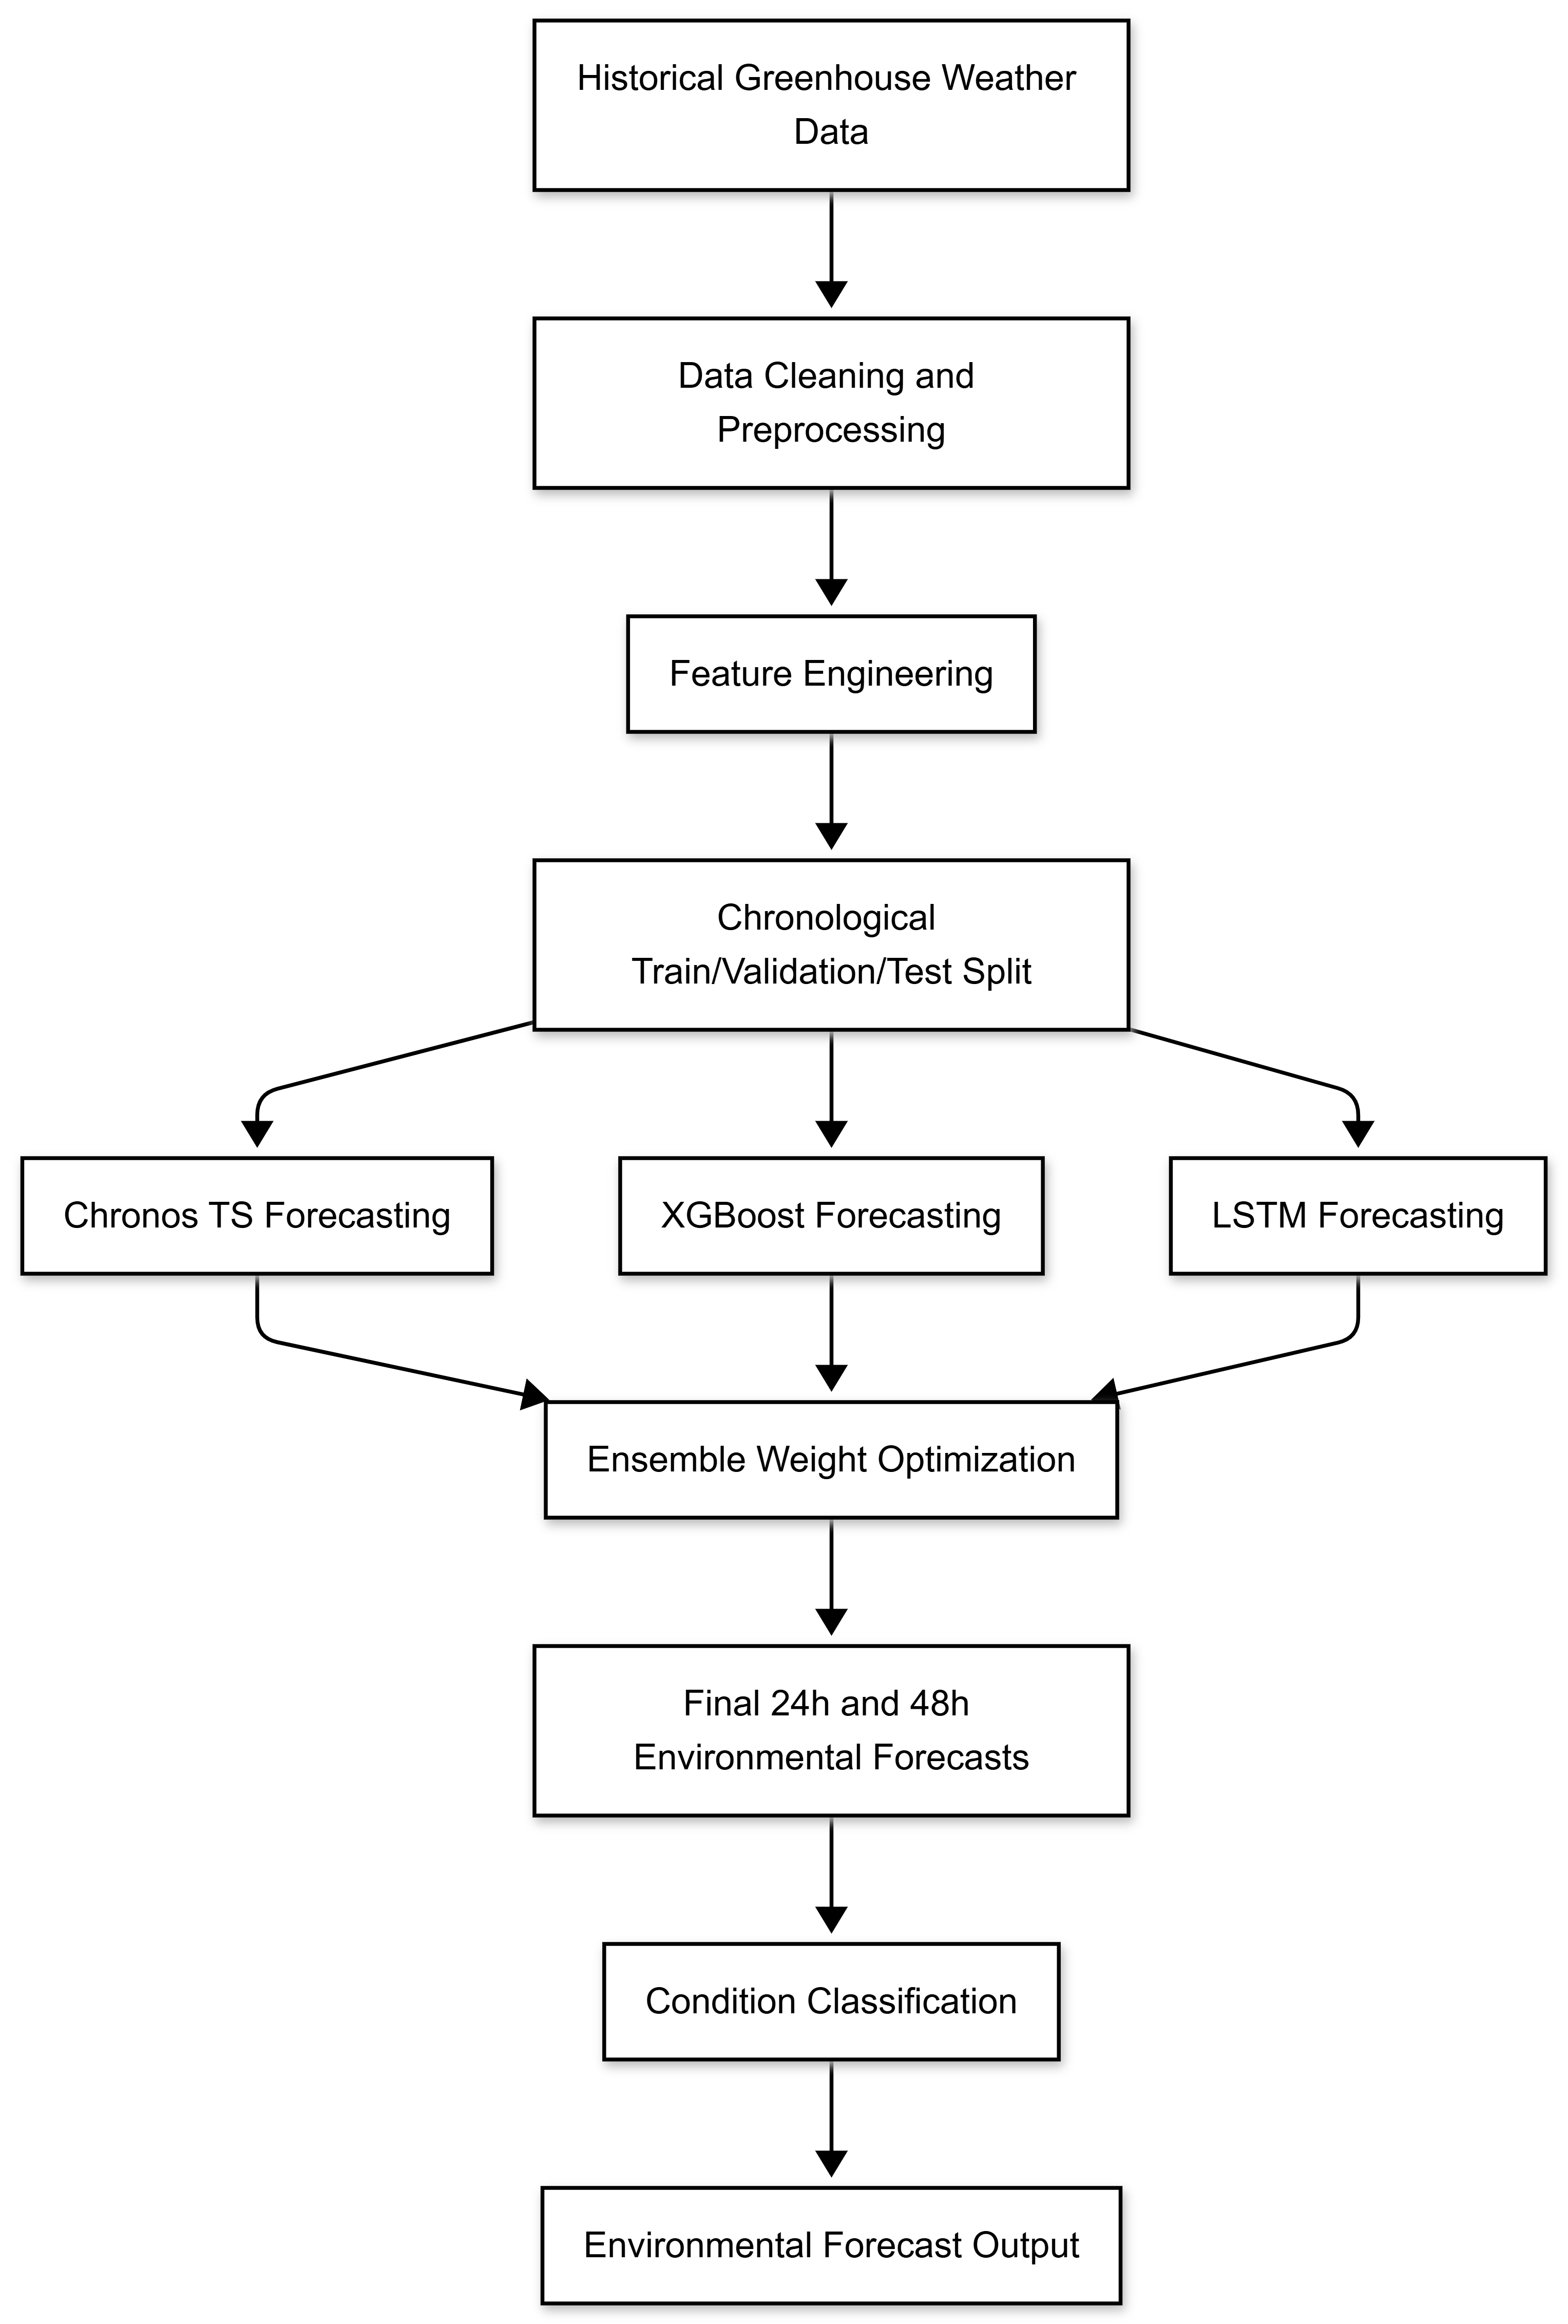
Project Modules (Contd..)
Fig. Weather Forecasting Model Architecture

Slide 27
Project Modules (Contd..)
Task 2 – Disease Risk Prediction
A time-series disease forecasting pipeline predicts presence, future severity (24h), and trend (absent, emerging, reducing, stable, worsening) for each disease, enabling proactive greenhouse intervention.
Data is structured from long to wide format, creating disease-specific features (presence, severity, targets, trends) while preserving multi-disease learning in a unified feature space.
Feature pipeline includes encoding and chronological splitting (70:15:15).
Baseline models use HistGradientBoosting (multi-output classification + regression) with lagged features, providing stable reference predictions and supporting hybrid blending.
Core models use LSTM/GRU sequence learning (24-hour windows) with a shared encoder and dual heads for presence classification and future severity regression.
Training includes EarlyStopping, ReduceLROnPlateau, checkpointing, and model selection between LSTM/GRU based on validation performance.

Slide 28
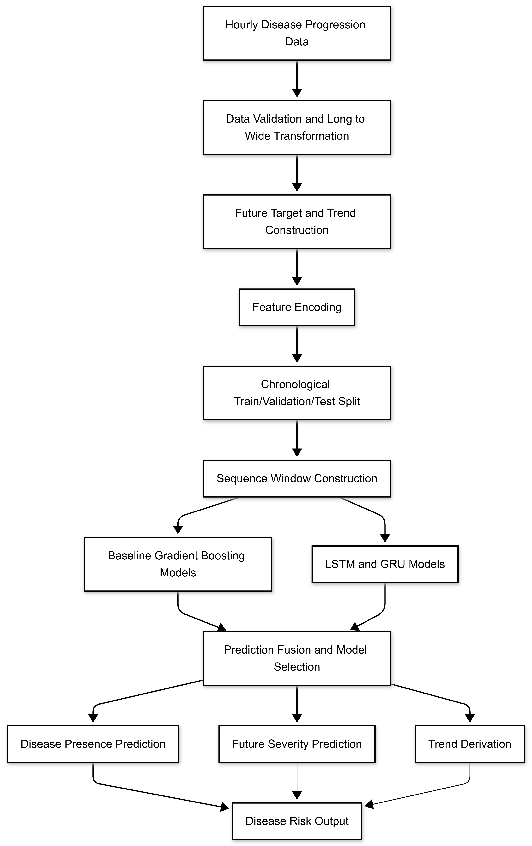
Project Modules (Contd..)
Fig. Disease Progression Prediction Model Architecture

Slide 29
Project Modules (Contd..)
Task 3 – Growth Forecasting
A sequence-based multi-task framework predicts current stage, next stage, hours to transition, and transition probabilities (24h, 48h) using greenhouse sensor time-series data.
Data is structured as hourly time-series across multiple plant growth cycles, ensuring biologically valid progression learning and generalization across unseen cycles.
Feature engineering includes rolling statistics (6h–24h), lag features, and environmental variables (temperature, humidity, CO₂, radiation) to capture growth dynamics.
Sequence modeling uses 24-hour sliding windows, enabling the model to learn temporal patterns across full day–night greenhouse cycles.
Baselines (Random Forest, XGBoost) provide tabular benchmarks, validating improvements from sequence-based deep learning approaches.
Core model uses a multi-task LSTM architecture for joint classification and regression of growth progression variables.
Training includes cross-entropy (classification), Huber loss (regression), early stopping, LR scheduling, and logical post-processing for consistent outputs.

Slide 30
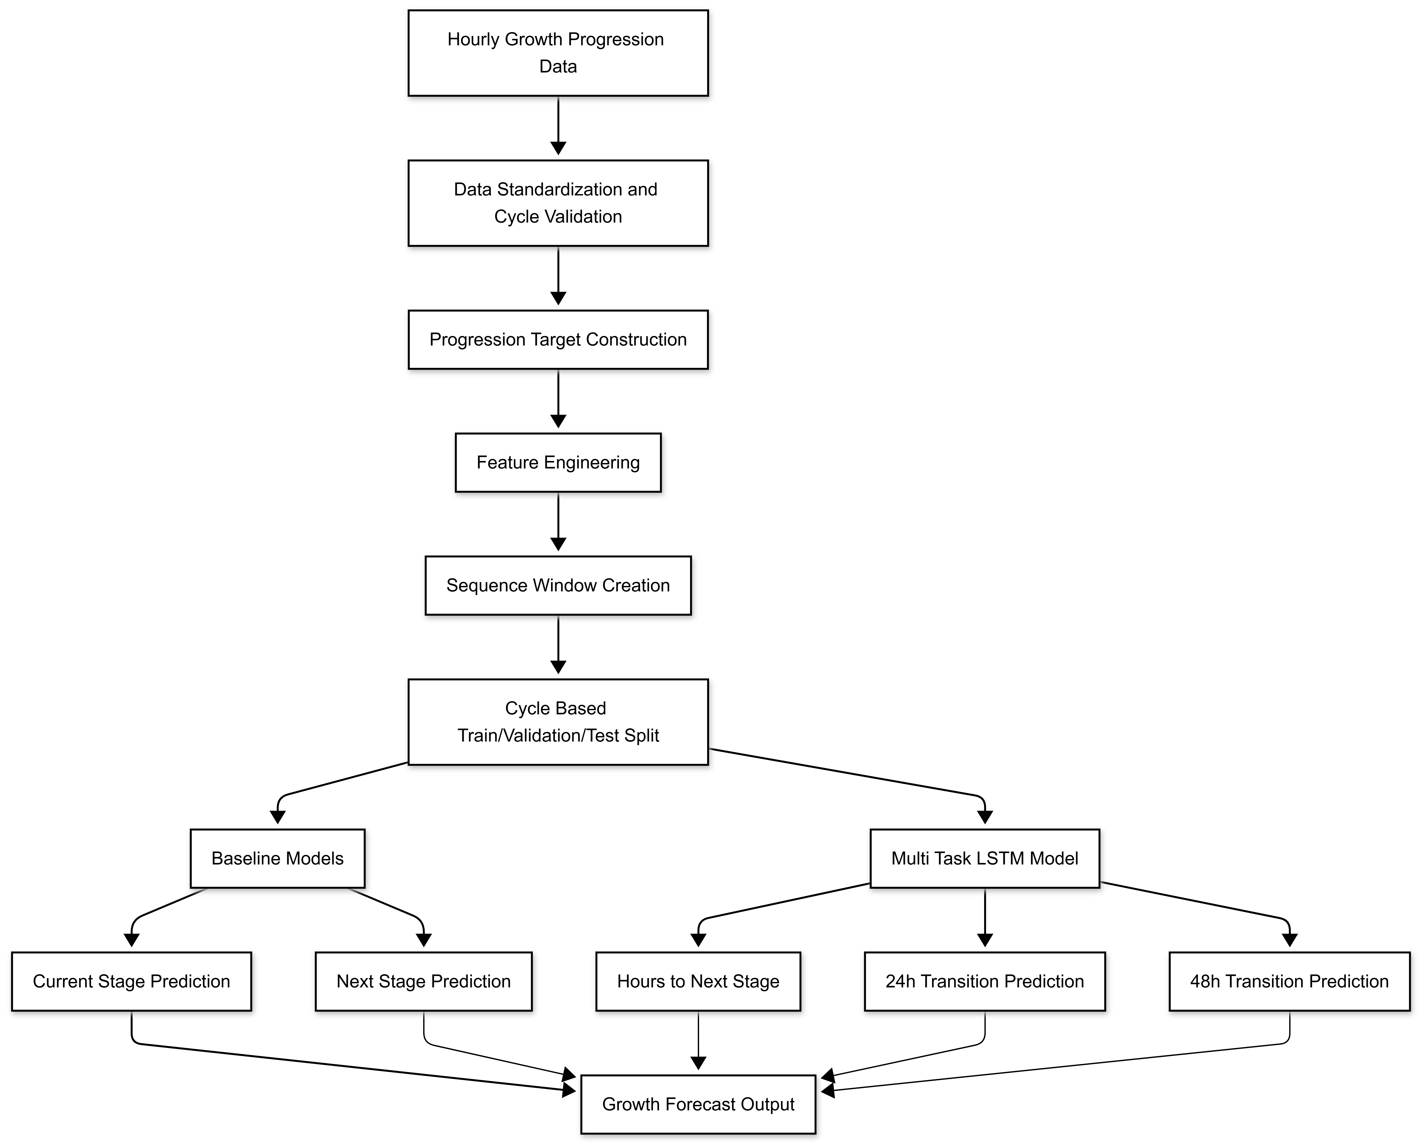
Project Modules (Contd..)
Fig. Growth Progression Prediction Model Architecture

Slide 31
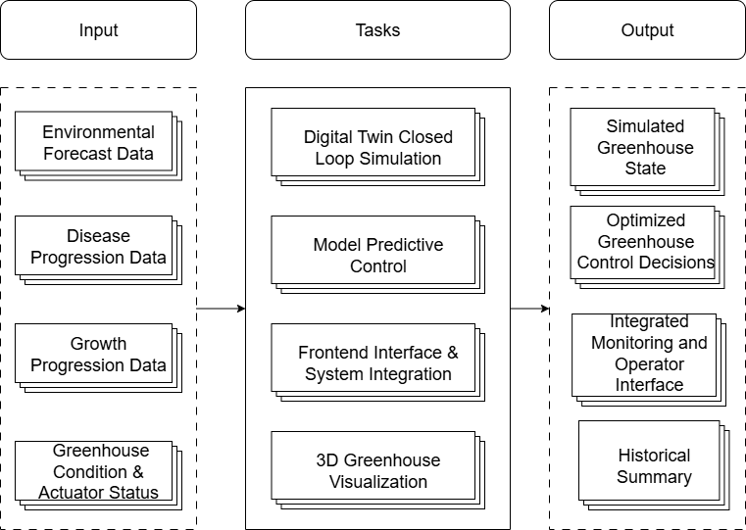
Project Modules (Contd..)
Module – III: Digital Twin Simulation and Intelligent Greenhouse Control
This module creates a digital twin closed-loop simulation continuously predicts greenhouse states, while a Model Predictive Control (MPC) framework generates optimal actuator decisions to maintain ideal crop conditions.
The system includes a backend API, frontend dashboard, and 3D visualization for real-time monitoring and interaction.
Fig. Task-Level Architecture of Digital Twin Simulation and Intelligent Greenhouse Control Module

Slide 32
Project Modules (Contd..)
Task 1 – Model Predictive Control
MPC acts as the core decision-making layer, integrating environmental forecasts, disease progression, crop growth stage, and greenhouse condition into a fused state for predictive greenhouse control.
Greenhouse dynamics are modeled using an ARX (Auto-Regressive with eXogenous inputs) model, enabling efficient prediction of future states based on current conditions, control actions, and disturbances.
MPC performs finite-horizon optimization, predicting future system behavior and computing optimal actuator actions to minimize deviation from desired crop-specific setpoints.
The optimization incorporates operational constraints, ensuring actuator limits and maintaining environmental variables within agronomically safe ranges.
The framework supports disease-aware and stage-specific control, allowing decisions to adapt based on crop growth phase and predicted disease risks.
Overall, MPC combines predictive modeling, constrained optimization, and AI-driven insights to enable adaptive, efficient, and intelligent greenhouse control.

Slide 33
Project Modules (Contd..)
Task 2 – Digital Twin Closed Loop Simulation
The DT loop acts as the execution backbone, maintaining a virtual greenhouse replica that predicts system evolution, evaluates actuator effects, and feeds results back into the control pipeline.
The system is structured into input (state, weather, disease, growth, images), simulation core (DT engine + MPC), and output (diagnostics, summaries, real-time updates) ensuring full pipeline integration.
DT reuses the same ARX greenhouse model, ensuring mathematical consistency between simulation and real control decisions.
Implements a multi-rate execution schedule: simulation every 5 min, MPC every 15 min, and image updates every 30 min, balancing responsiveness and computational efficiency.
Includes automatic growth stage progression and event-triggered MPC re-optimization, enabling both scheduled control and reactive safety handling.
Produces fully explainable outputs (energy, water, risk, errors, state deltas) and integrates with API, dashboard, and 3D visualization for real-time monitoring.

Slide 34
Project Modules (Contd..)
Task 3 – 3D Greenhouse Visualization
A real-time Unity-based 3D digital twin models the greenhouse environment with physics-based rendering, dynamic lighting, and scripted actuator interactions to reflect system behavior.
Actuator-driven animations ensure vent opening, fan rotation, irrigation activation, and lighting intensity dynamically respond to control signals from the system.
The model is deployed via Unity WebGL (WebAssembly + JavaScript), enabling browser-based access with optimized rendering, compression, and performance tuning.
Crop growth visualization uses stage-based modeling with model switching or smooth transitions aligned with prediction outputs.
Environmental realism is enhanced through time-of-day simulation (lighting variation), mist effects, and dynamic visual cues representing climate conditions.
Integration with the backend uses API-based real-time data exchange, where Unity updates object states, animations, and environment using simulation outputs.

Slide 35
Project Modules (Contd..)
Task 4 – Frontend Interface & System Integration
The frontend serves as the visualization and interaction layer, presenting real-time greenhouse state, crop stage, disease risk, and system health.
It provides dashboard, detailed insights, and manual control panels, enabling monitoring of actuator states, resource usage, forecasts, and user-driven configuration for control.
The FastAPI layer acts as a communication bridge between frontend, digital twin loop, MPC, and 3D visualization, exposing endpoints for state retrieval, control updates, and diagnostics.
The API supports multi-level data exchange, including actuator configuration, system metrics, validation of inputs, and integration with external visualization systems.
Overall, this layer enables real-time monitoring, user interaction, system integration, and long-term performance analytics, transforming the digital twin into a complete decision-support platform.

Slide 36
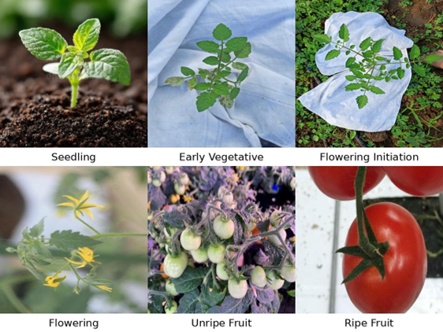
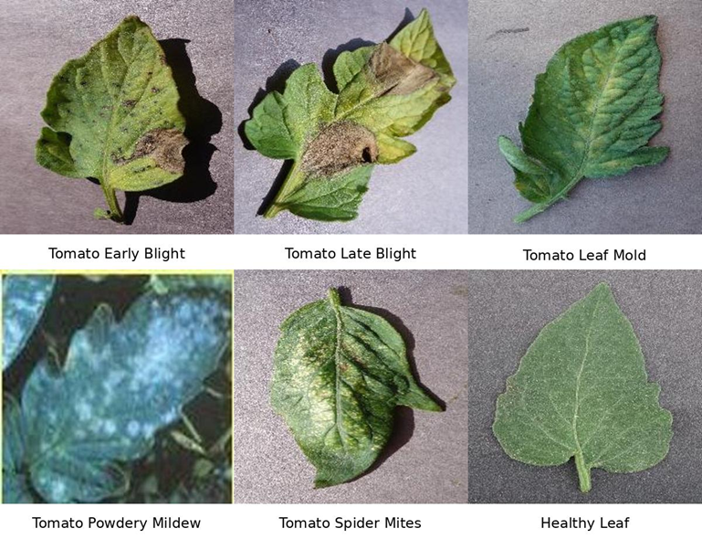
Results & Performance
Input Image Samples
Fig. Tomato Crop Growth Stages Dataset Samples
Fig. Tomato Leaf Disease Classification Dataset Samples

Slide 37
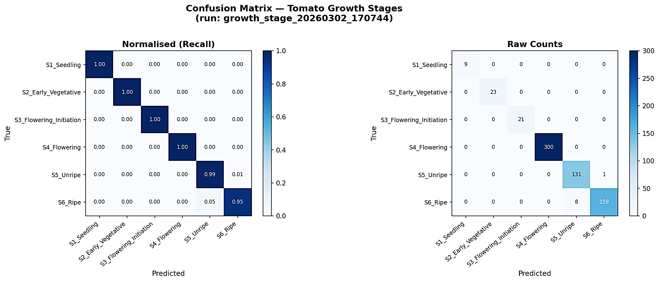
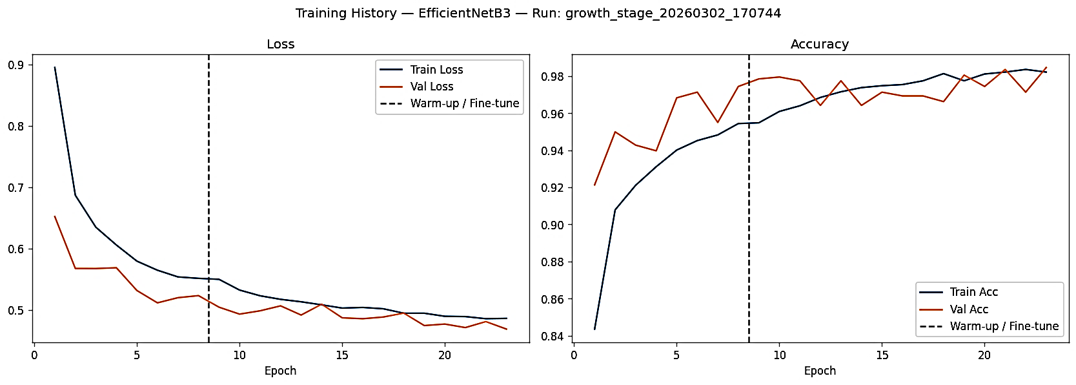
Results & Performance (Contd..)
Results of Crop Growth Stage Classification Model
Fig. Confusion Matrix of Tomato Growth Stage Classification Model
Fig. Training Accuracy of the Growth Stage Classification Model

Slide 38
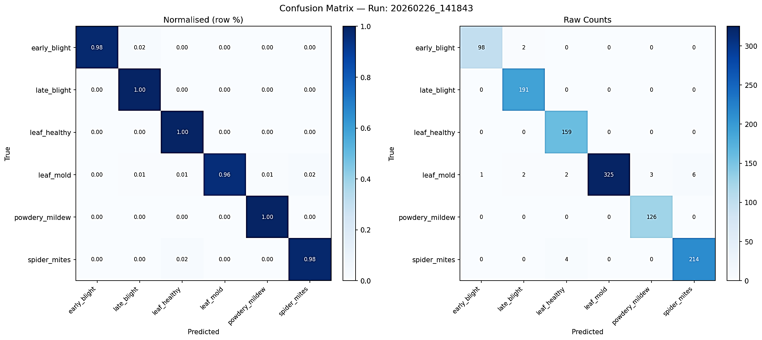
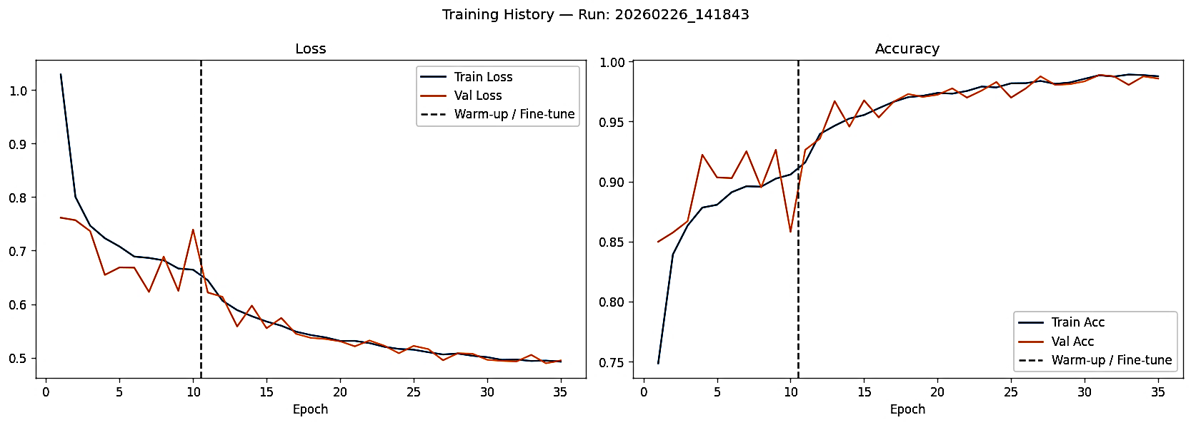
Results & Performance (Contd..)
Results of Plant Disease Detection Model
Fig. Confusion Matrix of Tomato Disease Detection Model
Fig. Training Accuracy of the Disease Detection Model

Slide 39
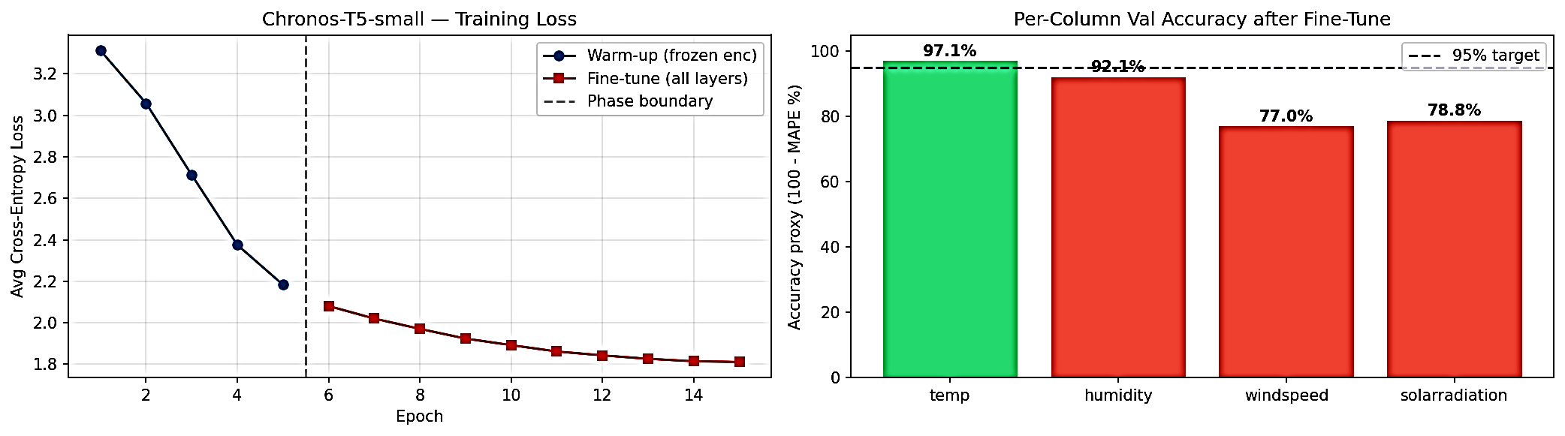
Results & Performance (Contd..)
Results of Weather Forecasting Model
Fig. Chronos Model Training Curve
Fig. Chronos Model Validation Accuracy after Fine-Tuning

Slide 40
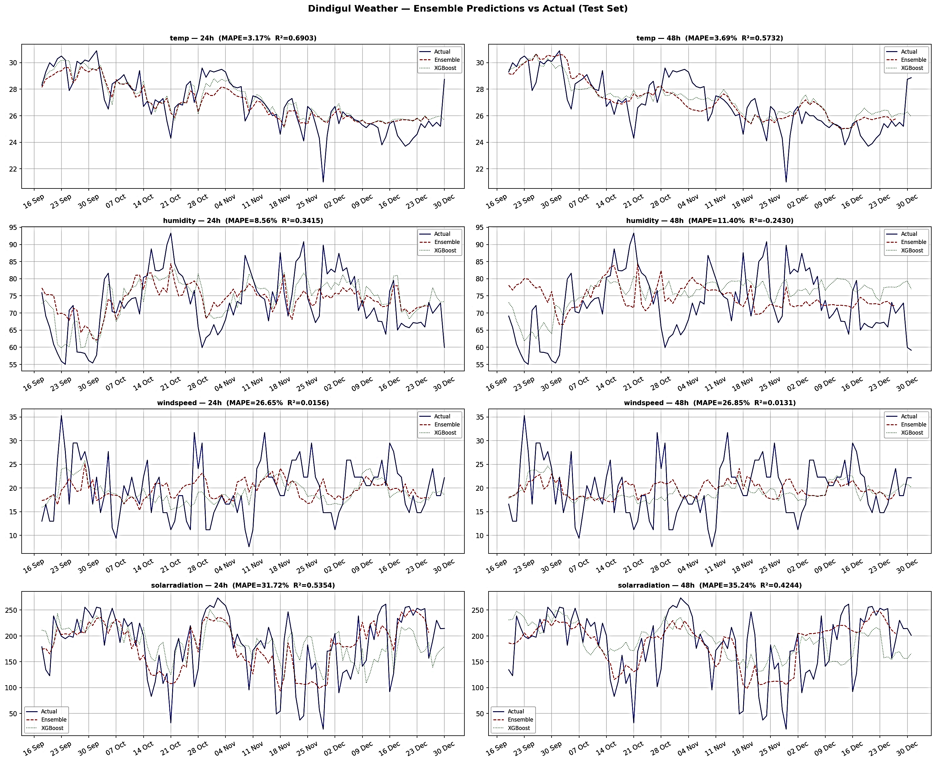
Results & Performance (Contd..)
Fig. Ensemble Weather Forecast Prediction versus Actual Values

Slide 41
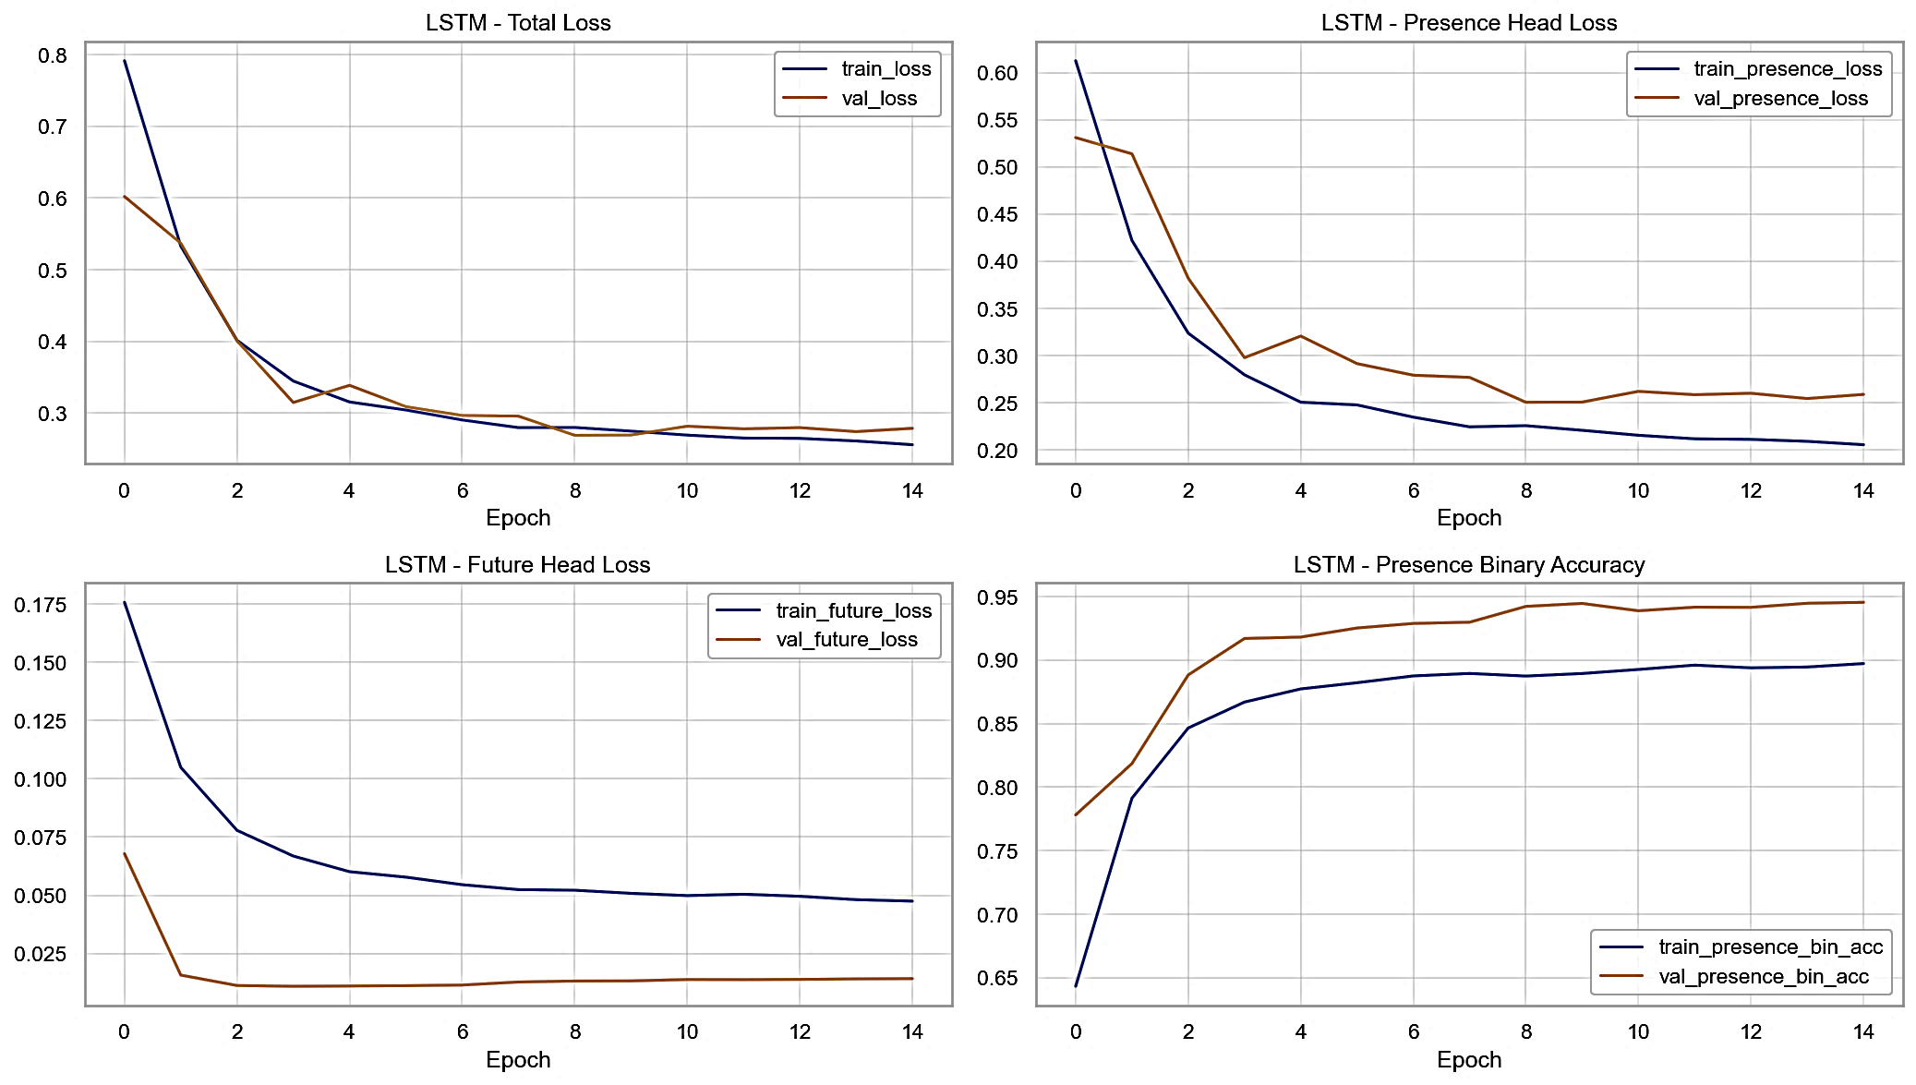
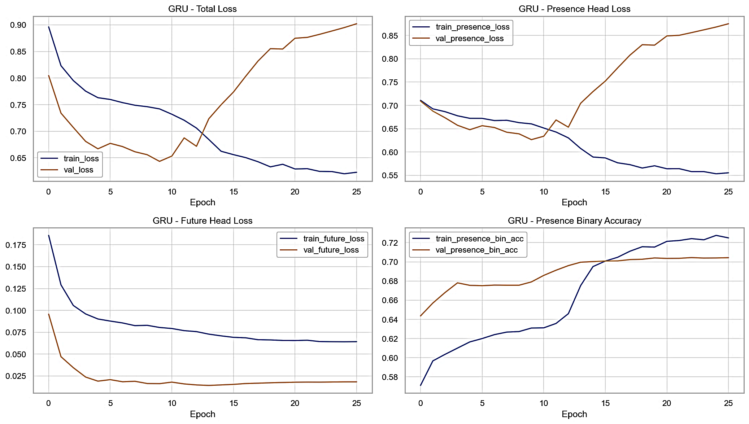
Results & Performance (Contd..)
Results of Disease Progression Model
Fig. LSTM Training Loss Curve for Disease Progression Model
Fig. GRU Training Loss Curve for Disease Progression Model

Slide 42
Results & Performance (Contd..)
Table. Performance Metrics for Disease Presence Classification Model
Table. Performance Metrics for Disease Severity Prediction
Metric | Value
Micro F1 Score | 0.800
Macro F1 Score | 0.801
Accuracy | 0.907
Metric | Value
Mean Absolute Error (MAE) | 3.297
Root Mean Square Error (RMSE) | 7.143
R² Score | 0.618

Slide 43
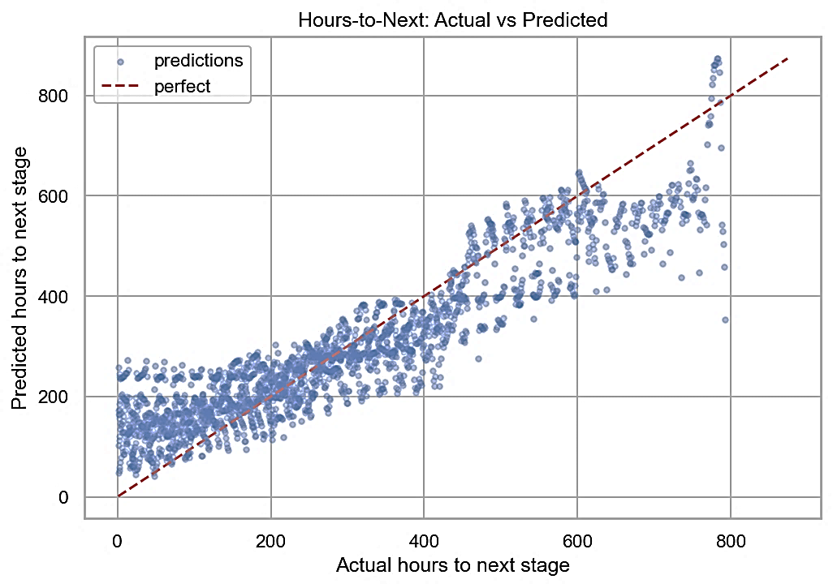
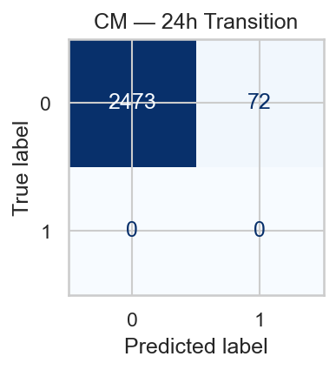
Results & Performance (Contd..)
Results of Crop Growth Progression Model
Fig. Actual versus Predicted Hours to Next Growth Stage
Fig. Confusion Matrix for 24-Hour Growth Stage Transition Prediction

Slide 44
Results & Performance (Contd..)
Table. Performance Metrics for Growth Stage Classification Model
Table. Performance Metrics for Growth Stage Transition Prediction
Metric | Value
Accuracy | 0.97
Precision (Macro) | 0.97
Recall (Macro) | 0.95
F1 Score (Macro) | 0.96
Metric | 24-Hour
Accuracy | 0.97
Precision (Macro) | 0.97
Recall (Macro) | 0.96
F1 Score (Macro) | 0.96

Slide 45
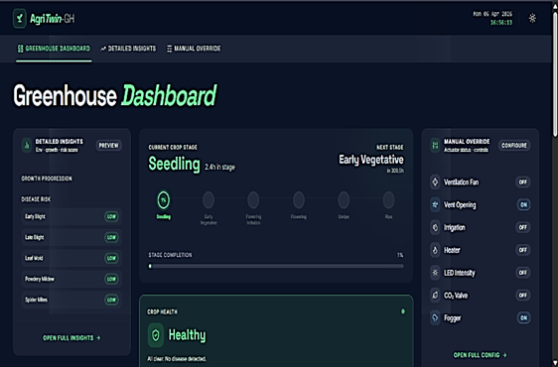
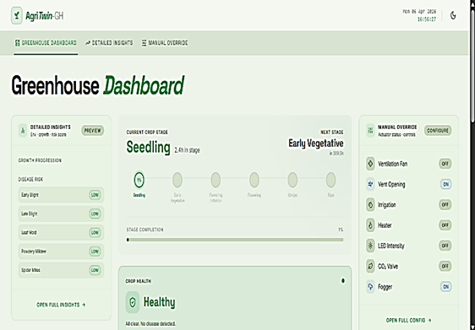
Results & Performance (Contd..)
System Interface and Execution Logs
Fig. Greenhouse Dashboard Interface in Dark Mode
Fig. Greenhouse Dashboard Interface in Light Mode

Slide 46
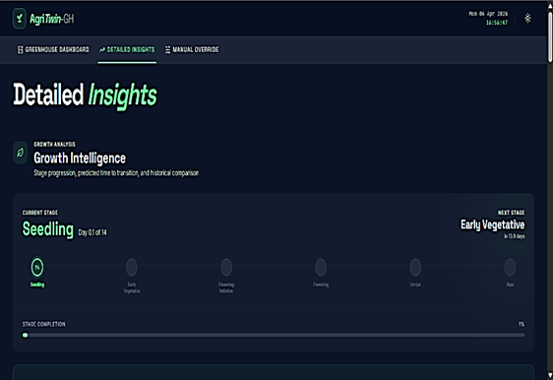
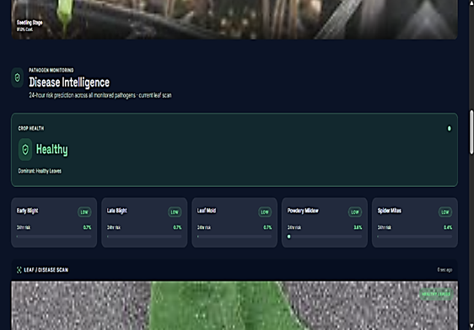
Results & Performance (Contd..)
Fig. Growth Intelligence Section in Detailed Insights Interface
Fig. Disease Intelligence Section in Detailed Insights Interface

Slide 47
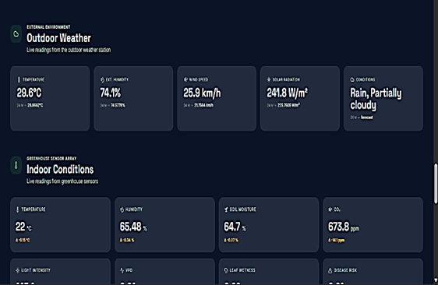
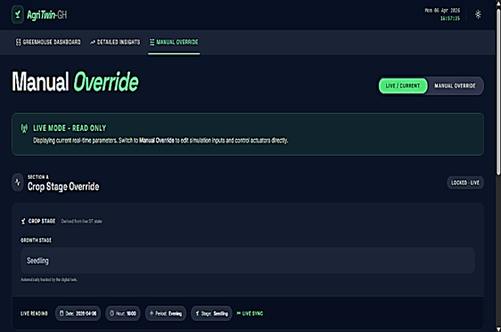
Results & Performance (Contd..)
Fig. Environmental Monitoring Section Showing Outdoor and Indoor Conditions
Fig. Manual Override Interface for Growth Stage and Actuator Control

Slide 48
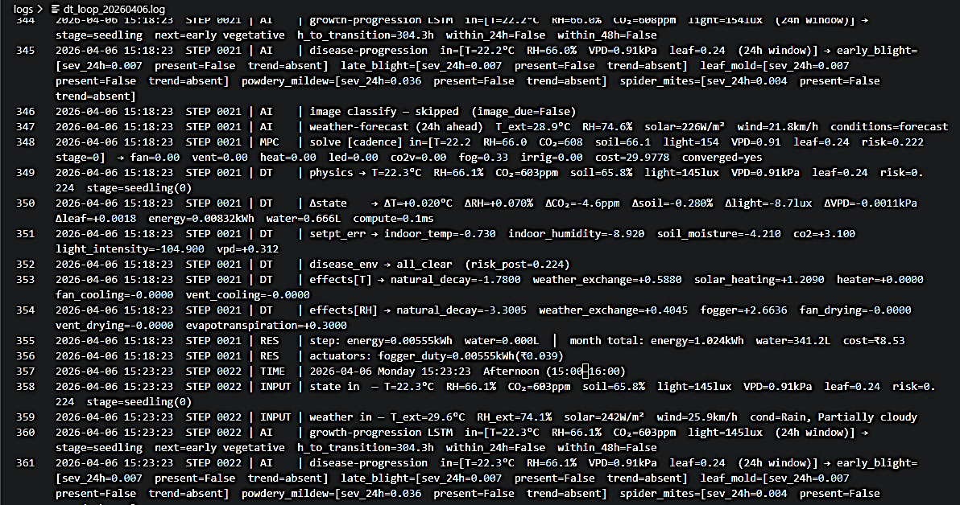
Results & Performance (Contd..)
Fig. Digital Twin Closed Loop Execution Log

Slide 49

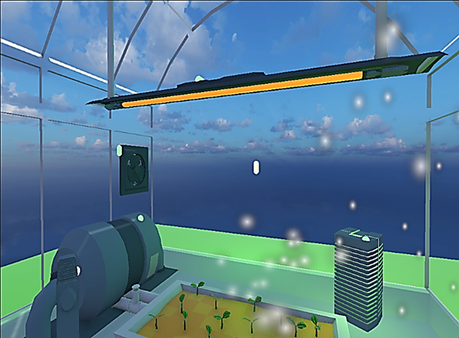
Results & Performance (Contd..)
3D Greenhouse Visualization
Fig. Front View of 3D Greenhouse Environment
Fig. Internal Right-Side View of Greenhouse in Active State

Slide 50
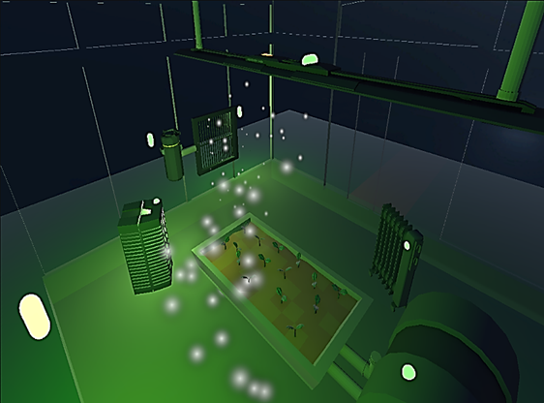
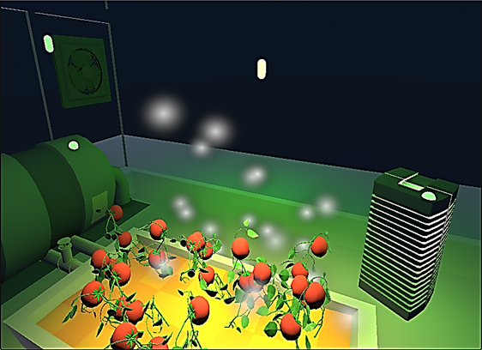
Results & Performance (Contd..)
Fig. Top-Left Perspective View of Greenhouse in Active State
Fig. Ripe Growth Stage Visualization inside 3D Greenhouse

Slide 51
Comparison with Existing Systems
Table. Comparative Analysis of Proposed Growth Stage and Disease Classification Models with Existing Approaches
Task Type | Model Approach | Architecture | Dataset | Accuracy(%)
Growth Stage (Existing) | CNN / Transfer Learning | ResNet / VGG / Custom CNN | Plant Image Datasets | ~95
Growth Stage (Proposed) | Deep Learning | EfficientNetB3 | Tomato Growth Stage Dataset | 98.61
Disease Detection (Existing) | CNN / Ensemble | ResNet / DenseNet / Ensemble | Leaf Disease Datasets | ~97
Disease Detection (Proposed) | Deep Learning | EfficientNetB0 | Tomato Leaf Disease Dataset | 98.23

Slide 52
Comparison with Existing Systems (Contd..)
Table. Performance Comparison of Weather Forecasting Models
Parameter | Existing Work | Proposed Work
Model Type | Numerical Weather Model (MM5) | Chronos + GRU-based Deep Learning Model & Random Forest Classification Model
Forecast Horizon | 3 Days | 2 Days
Variables Predicted | Solar Radiation, Temperature, Wind Speed, Humidity | Temperature, Wind Speed, Humidity, Solar Radiation, Weather Condition
MAE (Solar Radiation) | 45.365 | 35.13
R² (Solar Radiation) | 0.867 | 0.886
MAE (Temperature) | 32.361 | 0.84
R² (Temperature) | 0.844 | 0.943
MAE (Wind Speed) | 170.598 | 4.68
R² (Wind Speed) | 0.867 | 0.885
MAE (Humidity) | 10.715 | 6.078
R² (Humidity) | 0.581 | 0.629

Slide 53
Comparison with Existing Systems (Contd..)
Table. Comparative Analysis of Existing Systems and Proposed AgriTwin-GH Framework
Criteria | IoT-Based Systems | Digital Twin Systems | AgriTwin-GH (Proposed)
Monitoring Capability | Real-time sensor-based monitoring | Real-time + virtual monitoring | Multi-source intelligent monitoring
Disease Detection | Not supported | Limited | Integrated AI-based detection
Control Strategy | Semi-automated | Predictive (MPC-based) | Predictive + MPC & Simulation-based control
AI/ML Integration | Minimal | Moderate | Fully integrated AI framework
Decision Support | Limited | High | Intelligent decision-support system

Slide 54
Conclusion with Future Work
This work presented AgriTwin-GH, an AI-driven digital twin framework that integrates environmental data, plant intelligence, predictive analytics, and MPC for intelligent greenhouse management.
The system enables predictive and proactive decision-making, continuously analyzing environmental and plant data to detect early stress/disease, forecast crop development, and validate control strategies in a virtual greenhouse.
A key contribution is the sensor-independent digital twin, where processed datasets act as virtual sensors, reducing infrastructure requirements while maintaining reliable system behavior.
The framework improves crop health, resource efficiency, and operational reliability, providing a scalable and cost-effective solution for climate-resilient and precision agriculture.
Future work includes integration of real-time IoT sensors for full synchronization between physical greenhouse and digital twin. The system will be extended to multi-crop and multi-disease support.
Reinforcement learning-based control will be introduced to enable adaptive, self-improving decision strategies based on historical and real-time data. Further enhancements include edge AI deployment, scalability across greenhouse setups, and evaluation of resource efficiency, carbon reduction, and sustainability metrics.

Slide 55
Datasets Used
PlantVillage Dataset – Kaggle
URL: https://www.kaggle.com/datasets/arjuntejaswi/plant-village
Ripe and Unripe Tomatoes Dataset – Kaggle
URL: https://www.kaggle.com/datasets/adilshamim8/greenhouse-plant-growth-metrics
Tomato Disease Dataset – Mendeley Data
URL: https://data.mendeley.com/datasets/c2x8rynybg/1
Tomato-flower-3-class Dataset – Kaggle
URL: https://www.kaggle.com/datasets/jawadulkarim117/tomato-flower-3-class
TomatoPlantfactoryDataset – Mendeley Data
URL: https://data.mendeley.com/datasets/8h3s6jkyff/1
Tomato Plant Stages Dataset – Kaggle
URL: https://www.kaggle.com/datasets/arjunsudheer326/tomato-plant-stages-dataset

Slide 56
References
[1] L. Caroprese, M. Pierantozzi, C. Lops, and S. Montelpare, “DL2F: A deep learning model for the local forecasting of renewable sources,” Computers & Industrial Engineering, vol. 187, 109785, 2024.
[2] E. Elbasi, N. Mostafa, C. Zaki, Z. AlArnaout, A. E. Topcu, and L. Saker, “Optimizing agricultural data analysis techniques through AI-powered decision-making processes,” Applied Sciences, vol. 14, no. 8018, 2024.
[3] M. Ghiasi, Z. Wang, M. Mehrandezh, and A. Mohammadi, “Optimal strategy for energy-efficient management of greenhouse climate control,” IEEE Open Access Journal of Power and Energy, vol. 12, pp. 1–14, Dec. 2025.
[4] T. He, M. Li, and D. Jin, “Deep learning-based time series prediction for precision field crop protection,” Frontiers in Plant Science, vol. 16, 1575796, 2025.
[5] D. A. Howard, Z. Ma, C. Veje, A. Clausen, J. M. Aaslyng, and B. N. Jørgensen, “Greenhouse industry 4.0 – digital twin technology for commercial greenhouses,” Energy Informatics, vol. 4, no. 1, pp. 1–20, May 2021.
[6] Y. Huo, Y. Liu, P. He, L. Hu, W. Gao, and L. Gu, “Identifying tomato growth stages in protected agriculture with StyleGAN3–synthetic images and Vision Transformer,” Agriculture, vol. 15, no. 120, 2025.
[7] D. S. Joseph, P. M. Pawar, and K. Chakradeo, “Real-time plant disease dataset development and detection of plant disease using deep learning,” IEEE Access, vol. 11, pp. 1–15, 2023.

Slide 57
References (Contd..)
[8] S. Kanakala and S. Ningappa, “Detection and classification of diseases in multi-crop leaves using LSTM and CNN models,” Journal of Innovative Image Processing, vol. 7, no. 1, pp. 161–181, Mar. 2025.
[9] A. Kaur and R. Kaur, “AI-enabled energy management for sustainable smart greenhouses: An integrated review,” Journal of Cleaner Production, vol. 382, pp. 1–15, 2024.
[10] D. K. Lee, B. K. Kang, Y. J. Kim, T. G. An, and Y. T. Chae, “A digital twin-based framework for precision tomato cultivation: Integrating XGBoost-based prediction with model predictive control,” SSRN Electronic Journal, 2024.
[11] S. R. Luna, M. P. García, and J. R. Torres, “Digital twin technology in greenhouse-based precision agriculture,” Computers and Electronics in Agriculture, vol. 209, pp. 107–119, 2023.
[12] B. V. Nikitha, N. K. S. Keerthan, P. Praneeth, and T. Amrita, “Leaf disease detection and classification,” Procedia Computer Science, vol. 218, pp. 291–300, Jan. 2023.
[13] A. Oad, S. S. Abbas, A. Zafar, et al., “Plant leaf disease detection using ensemble learning and explainable AI,” IEEE Access, vol. 12, pp. 156038–156052, 2024.
[14] A. Soussi, E. Zero, C. D. C. Herrera, et al., “Integrating digital twins and model predictive control for sustainable greenhouse management in smart agriculture,” IEEE Transactions on AgriFood Electronics, vol. 1, no. 1, pp. 1–17, 2025.
[15] A. F. Subahi and K. E. Bouazza, “An intelligent IoT-based system design for controlling and monitoring greenhouse temperature,” IEEE Access, vol. 10, pp. 1–12, 2022.

Slide 58
References (Contd..)
[16] R. A. Tathed, “Designing AI-driven platforms to transform agricultural ecosystems,” International Journal for Research Publication and Seminar, vol. 16, no. 2, pp. 249–268, Apr.–Jun. 2025.
[17] M. Umar, S. Altaf, S. Ahmad, H. Mahmoud, A. S. N. Mohamed, and R. Ayub, “Precision agriculture through deep learning: Tomato plant multiple diseases recognition with CNN and improved YOLOv7,” IEEE Access, vol. 12, pp. 49167–49180, Apr. 2024.
[18] Y. Zhang, X. Wang, et al., “Data-driven robust model predictive control for greenhouse temperature control and energy utilisation assessment,” Applied Energy, 2023.
[19] Z. Zhang, J. Li, and Y. Wang, “Digital twin-driven smart greenhouse management using deep learning and IoT integration,” Computers and Electronics in Agriculture, 2024.
[20] Z. Zhao, Y. Zhou, and X. Zhu, “Deep learning-enabled digital twin framework for precision greenhouse agriculture,” Computers and Electronics in Agriculture, 2025.

Slide 59
Thank you

